Slide 1
Computer Organization and Design Instruction Sets - 1
Montek Singh
Feb 1-3, 2016
Lecture 4

Slide 2
Representing Instructions
Today’s topics
von Neumann model of a computer
Instruction set architecture
MIPS instruction formats
Some MIPS instructions
Reading
P&H textbook Ch. 2.1-2.2, Ch. 2.5-2.6

Slide 3
A General-Purpose Computer
The von Neumann Model
Many architectural models for a general-purpose computer have been explored
Most of today’s computers based on the model proposed by John von Neumann in the late 1940s
Its major components are:
Input/
Output
Central
Processing Unit
Main
Memory
Central Processing Unit (CPU): Fetches, interprets, and executes a specified set of operations called Instructions.
Memory: storage of N words of W bits each, where W is a fixed architectural parameter, and N can be expanded to meet needs.
I/O: Devices for communicating with the outside world.

Slide 4
Instructions and Programs
What are instructions?
the words of a computer’s language
Instruction Set
the full vocabulary
Stored Program Concept
The idea that instructions and data of many types can be stored in memory as numbers, leading to the stored program computer
Distinct from “application-specific” hardware, which is “hardwired” to perform “fixed-function” processing on inputs
Distinct from punched tape computers (e.g., looms) where instructions were not stored, but streamed in one at a time

Slide 5
Anatomy of an Instruction
An instruction is a primitive operation
Instructions specify an operation and its operands (the necessary variables to perform the operation)
Types of operands: immediate, source, and destination
Operation
Operands (variables, arguments, etc.)
add $t0, $t1, $t2
$X is a convention to denote the contents of a “register”, which is a location inside the CPU. In contrast, immediate operands indicate the value itself
Source Operands
Destination Operand
Immediate Operand
addi $t0, $t1, 1

Slide 6
Meaning of an Instruction
Operations are abbreviated into opcodes (1-4 letters)
Instructions are specified with a very regular syntax
First an opcode followed by arguments
Usually (but not always) the destination is next, then source
Why this order? Arbitrary…
… but analogous to high-level language like Java or C
add $t0, $t1, $t2
implies
The instruction syntax provides operands in the same order as you would expect in a statement from a high level language.
int t0, t1, t2
t0 = t1 + t2

Slide 7
Being the Machine!
Instruction sequence
Instructions are executed sequentially from a list …
… unless some special instructions alter this flow
Instructions execute one after another
therefore, results of all previous instructions have been computed
Instructions
Variables
add $t0, $t1, $t1
$t0: 0
12
24
48
add $t0, $t0, $t0
What is this program doing?
$t1: 6
42
add $t0, $t0, $t0
$t2: 8
sub $t1, $t0, $t1
$t3: 10
Notes:
A program is just a definite set of intructions
One line at a time
Read from top to bottom, on the right you have variable values
The first instruction, adds two t1’s and stores them into t0…. T1 is 6 so t0 becomes 12

Slide 8
What did this machine do?
Let’s repeat the simulation, this time using unknowns
CLASS: What is this machine doing?
Knowing what the program does allows us to write down its specification, and give it a meaningful name
Instructions
Variables
times7:
add $t0, $t1, $t1
$t0: w
2x
4x
8x
add $t0, $t0, $t0
$t1: x
7x
add $t0, $t0, $t0
$t2: y
sub $t1, $t0, $t1
$t3: z

Slide 9
Looping the Flow
Need something to change the instruction flow
“go back” to the beginning
a jump instruction with opcode ‘j’
the operand refers to a label of some other instruction
for now, this is a text label you assign to an instruction
in reality, the text label becomes a numerical address
Instructions
Variables
times7:
add $t0, $t1, $t1
$t0: w
8x
56x
392x
add $t0, $t0, $t0
An infinite loop
49x
343x
$t1: x
7x
add $t0, $t0, $t0
$t2: y
sub $t1, $t0, $t1
$t3: z
j times7

Slide 10
Open Questions in our Simple Model
We will answer the following questions next
WHERE are INSTRUCTIONS stored?
HOW are instructions represented?
WHERE are VARIABLES stored?
How are labels associated with particular instructions?
How do you access more complicated variable types:
Arrays?
Structures?
Objects?
Where does a program start executing?
How does it stop?

Slide 11
The Stored-Program Computer
The von Neumann model:
Instructions and Data stored in a common memory (“main memory”)
Sequential semantics: All instructions execute sequentially (or at least appear sequential to the programmer)
Main Memory
instruction
instruction
Key idea: Memory holds not only data, but coded instructions that make up a program.
instruction
Central
Processing Unit
data
data
CPU fetches and executes instructions from memory ...
The CPU is a hardware interpreter
Program IS simply data for this interpreter
Main memory: Single expandable resource pool - constrains both data and program size - don’t need to make separate decisions of how large of a program or data memory to buy
data
Notes:
Any program done in machine language is one instruction at a time

Slide 12
Anatomy of a von Neumann Computer
Data
Path
control
Control Unit
registers
status
address
data
address
instructions
MEMORY
Register 0
+1
PC
1101000111011
Register 1
R1 ←R2+R3
• INSTRUCTIONS coded in binary
• PROGRAM COUNTER or PC: Address of next instruction to be executed
• Control Unit has circuitry inside to translate instructions into control signals for data path
Register 31
“Register File”

Slide 13
Instruction Set Architecture (ISA)
Definition:
The part of the computer architecture related to programming, including the native data types, instructions, registers, addressing modes, memory architecture, interrupt and exception handling, and external I/O
An ISA includes a specification of the set of opcodes (machine language), and the native commands implemented by a particular processor

Slide 14
Instruction Set Architecture (ISA)
Encoding of instructions raises interesting choices...
Tradeoffs: performance, compactness, programmability
Complexity
How many different instructions? What level operations?
Level of support for particular software operations: array indexing, procedure calls, “polynomial evaluate”, etc.
“Reduced Instruction Set Computer” (RISC) philosophy: simple instructions, optimized for speed
Uniformity
Should different instructions be same size?
Take the same amount of time to execute?
Trend favors uniformity ➔ simplicity, speed, cost/power
Mix of Engineering & Art...
Trial (by simulation) is our best technique for making choices!
Our representative example: the MIPS architecture!

Slide 15
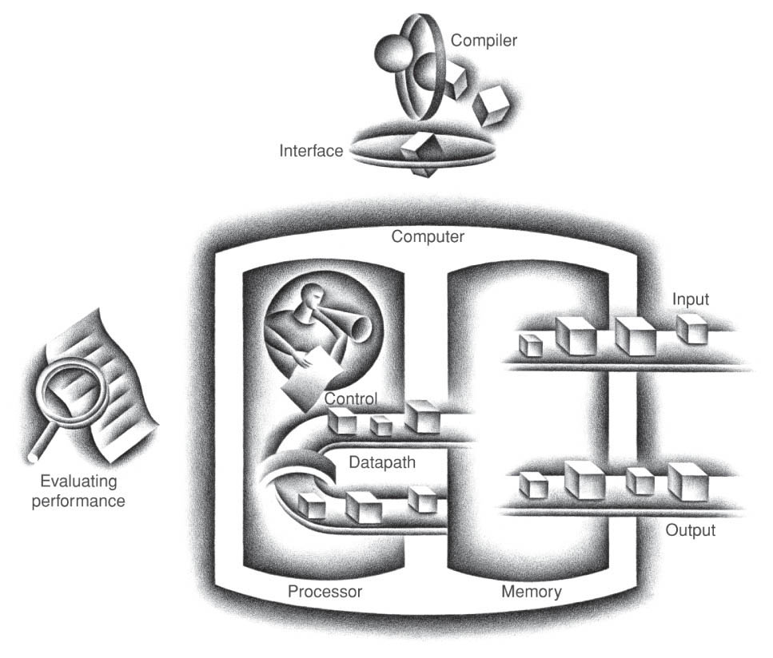
The big picture
A few things to note:
Memory is distinct from data path
Registers are in data path
Program is stored in memory
Control unit fetches instructions from memory
Control unit tells data path what to do
Data can be moved from memory to registers, or from registers to memory
All data processing (e.g., arithmetic) takes place within the data path
Data
Path
control
Control Unit
registers
status
address
data
address
instructions
MEMORY

Slide 16
MIPS Programming Model a representative simple RISC machine
Processor State (inside the CPU)
Main Memory
In Comp 411 we’ll use a clean and sufficient subset of the
MIPS-32 core Instruction set.
PC
00
Addresses
31
0
0 4
8
16 20
3
2
1
0
Fetch/Execute loop:
fetch Mem[PC]
PC = PC + 4†
execute fetched instruction (may change PC!)
repeat!
r0
000000....0
32 bit “words”
r1
(4 bytes)
r2
...
32 bit “words”
next instruction
r31
†MIPS uses byte memory addresses. However, each instruction is 32-bits wide, and *must* be aligned on a multiple of 4 (word) address. Each word contains four 8-bit bytes. Addresses of consecutive instructions (words) differ by 4.
General Registers:
A small scratchpad of frequently used or temporary variables
Notes:
32 bits only can be stored inside each registar
In main memory, first row is address 0 and there are 4 bytes inside of it. With address 0, 1, 2 ,3
Next row has addresses of

Slide 17
Some MIPS Memory Nits
Memory locations are 32 bits wide
BUT, they are addressable in different-sized chunks
8-bit chunks (bytes)
16-bit chunks (shorts)
32-bit chunks (words)
64-bit chunks (longs/double)
We also frequently need access to individual bits! (Instructions help w/ this)
Every BYTE has a unique address (MIPS is a byte-addressable machine)
Every instruction is one word
short2 short0
byte3 byte2 byte1 byte0
Addr
0:
4:
8:
12:
31 30 29 … … 4 3 2 1 0
3
2
1
0
long0
long8
7
6
5
4
12
10
9
8
15
14
13
12
Notes:
Bytes can go everywhere.
Shorts can go in either 0&1 or 3&2.

Slide 18
MIPS Register Nits
There are 32 named registers [$0, $1, …. $31]
The operands of all ALU instructions are registers
This means to operate on a variables in memory you must:
Load the value/values from memory into a register
Perform the instruction
Store the result back into memory
Going to and from memory can be expensive
(4x to 20x slower than operating on a register)
Net effect: Keep variables in registers as much as possible!
Special purpose and conventions
2 registers have specific “side-effects”
(ex: $0 always contains the value ‘0’… more later)
4 registers dedicated to specific tasks by convention
26 available for general use, but constrained by convention

Slide 19
MIPS Instruction Formats
All MIPS instructions fit into a single 32-bit word
Every instruction includes various “fields”:
a 6-bit operation or “OPCODE”
specifies which operation to execute (fewer than 64)
up to three 5-bit OPERAND fields
each specifies a register (one of 32) as source/destination
embedded constants
also called “literals” or “immediates”
16-bits, 5-bits or 26-bits long
sometimes treated as signed values, sometimes unsigned
There are three basic instruction formats:
R-type, 3 register operands (2 sources, destination)
r_{s}
r_{t}
r_{d}
OP
shamt
func
I-type, 2 register operands, 16-bit constant
r_{s}
r_{t}
OP
16-bit constant
J-type, no register operands, 26-bit constant
OP
26-bit constant
Notes:
64 different operations because there are 6 bits, aka 2^6 different operations.

Slide 20
MIPS ALU Operations
Sample coded operation: ADD instruction
References to register contents are prefixed by a “$” to distinguish them from constants or memory addresses
R-type:
0
0
0
0
0
0
0
1
0
1
1
0
1
0
0
1
0
1
0
1
0
0
0
0
0
0
1
0
0
0
0
0
op = 0x00 dictating an ALU function
func = 0x20 dictating an add
rs = 11 Reg[11]
source
rd = 10 Reg[10]
destination
rt = 9 Reg[9]
source
unused fields are set to ‘0’
What we prefer to write: add $10, $11, $9 (“assembly language”)
The convention with MIPS assembly language is to specify the destination operand first, followed by source operands.
Similar instructions for other ALU operations:
add rd, rs, rt:
arithmetic: add, sub, addu, subu
compare: slt, sltu
logical: and, or, xor, nor
shift: sll, srl, sra, sllv, srav, srlv
Reg[rd] = Reg[rs] + Reg[rt]
“Add the contents of rs to the contents of rt; store the result in rd”
Notes:
Register 10 gets the value register 11 + register 9
At the binary level, 11 and 9 get added first

Slide 21
Shift operations
Shifting is a common operation
applied to groups of bits
used for alignment
used for “short cut” arithmetic operations
X << 1 is often the same as 2*X
X >> 1 can be the same as X/2
For example:
X = 20₁₀ = 00010100₂
Left Shift:
(X << 1) = 00101000₂ = 40₁₀
Right Shift:
(X >> 1) = 00001010₂ = 10₁₀
Signed or “Arithmetic” Right Shift:
(-X >>> 1) = (11101100₂ >>> 1) = 11110110₂ = -10₁₀

Slide 22
MIPS Shift Operations
Sample coded operation: SLLV (SLL Variable)
This is peculiar syntax for MIPS, in this ALU instruction the rt operand precedes the rs operand. Usually, it’s the other way around
R-type:
0
0
0
0
0
0
0
0
1
0
0
0
0
0
1
0
0
0
0
1
0
0
0
0
0
0
0
0
0
1
0
0
op = 0x00 dictating an ALU function
func = 0x04 dictating an sllv
shift
amount
in rs
rd = 2 Reg[2]
destination
rt = 2 Reg[2]
source
unused set to ‘0’
Different flavor:
Shift amount is not in instruction, but in a register
Assembly: sllv $2, $2, $8
sllv rd, rt, rs:
Reg[rd] = Reg[rt] << Reg[rs]
“Shift the contents of rt left by the contents of rs; store the result in rd”

Slide 23
MIPS ALU Operations with Immediate
addi instruction: adds register contents, signed-constant:
I-type:
0
0
1
0
0
0
0
1
0
1
1
0
1
0
0
1
1
1
1
1
1
1
1
1
1
1
1
1
1
1
0
1
OP = 0x08, dictating addi
rs = 11, Reg[11] source
rt = 9, Reg[9] destination
constant field, indicating -3 as second operand
(sign-extended!)
Symbolic version: addi $9, $11, -3
addi rt, rs, imm:
Similar instructions for other ALU operations:
Immediate values are sign-extended for arithmetic and compare operations, but not for logical operations.
Reg[rt] = Reg[rs] + sxt(imm)
arithmetic: addi, addiu
compare: slti, sltiu
logical: andi, ori, xori, lui
“Add the contents of rs to const; store result in rt”

Slide 24
Why Built-in Constants? (Immediate)
Where are constants/immediates useful?
SMALL constants used frequently (50% of operands)
In a C compiler (gcc) 52% of ALU operations use a constant
In a circuit simulator (spice) 69% involve constants
e.g., B = B + 1; C = W & 0x00ff; A = B + 0;
Examples: addi $29, $29, 4 slti $8, $18, 10 andi $29, $29, 6 ori $29, $29, 4

Slide 25
First MIPS Program (fragment)
Suppose you want to compute the expression:
f = (g + h) – (i + j)
where variables f, g, h, i, and j are assigned to registers $16, $17, $18, $19, and $20 respectively
what is the MIPS assembly code?
Questions to answer:
How did these variables come to reside in registers?
Answer: We need more instructions which allow data to be explicitly loaded from memory to registers, and stored from registers to memory
add $8,$17,$18 # (g + h)
add $9,$19,$20 # (i + j)
sub $16,$8,$9 # f = (g + h) – (i + j)

Slide 26
MIPS Register Usage Conventions
Some MIPS registers assigned to specific uses
by convention, so programmers can combine code pieces
will cover the convention later
$0 is hard-wired to the value 0

Slide 27
Continue next lecture…
More instructions
accessing memory
branches and jumps
larger constants
multiply, divide
etc.

